Slide 1
CST 2355 – Database Systems
Week 12

Slide 2
Topics Covered:
Oracle
PL/SQL Functions, Packages (continued)
Sharing items in package memory
Built-in Functions and Packages
Performance considerations
Indexes
Transactions (commit, rollback)
Views, materialized views
Container database

Slide 3
Oracle – Packages & Public Items
See: https://docs.oracle.com/database/121/LNPLS/packages.htm#LNPLS00911
Package public variables and cursors can persist for the life of a session. They can be shared by all subprograms that run in the environment. They let you maintain data across transactions without storing it in the database.
Recall: The first time you invoke a package subprogram, Oracle Database loads the whole package into memory. Subsequent invocations of other subprograms in the same package require no disk I/O.
You can grant roles on the package, instead of granting roles on each object in the package.

Slide 4
Oracle – Packages & Public Items
Appropriate public items are:
Types, variables, constants, subprograms, cursors, and exceptions used by multiple subprograms
Associative array types of standalone subprogram parameters
You cannot declare an associative array type at schema level. Therefore, to pass an associative array variable as a parameter to a standalone subprogram, you must declare the type of that variable in a package specification. Doing so makes the type available to both the invoked subprogram (which declares a formal parameter of that type) and to the invoking subprogram or anonymous block (which declares a variable of that type). See Example 10-2.
Variables that must remain available between subprogram invocations in the same session
Subprograms that read and write public variables ("get" and "set" subprograms)
Provide these subprograms to discourage package users from reading and writing public variables directly.
Subprograms that invoke each other
You need not worry about compilation order for package subprograms, as you must for standalone subprograms that invoke each other.
Overloaded subprograms
Overloaded subprograms are variations of the same subprogram. That is, they have the same name but different formal parameters. For more information about them, see "Overloaded Subprograms".
Make sure you look at Example 10-2 (Example 10-2) …

Slide 5
Oracle – Built-in Functions & Packages
MANY Functions:
See: https://docs.oracle.com/database/121/SQLRF/functions.htm#SQLRF006
Single Row Functions:
See: https://docs.oracle.com/database/121/SQLRF/functions002.htm#SQLRF51178
Single-row functions return a single result row for every row of a queried table or view. These functions can appear in select lists, WHERE clauses, START WITH and CONNECT BY clauses, and HAVING clauses
Aggregate Functions:
See: https://docs.oracle.com/database/121/SQLRF/functions003.htm#SQLRF20035
Aggregate functions return a single result row based on groups of rows, rather than on single rows. Aggregate functions can appear in select lists and in ORDER BY and HAVING clauses. They are commonly used with the GROUP BY clause in a SELECT statement
Analytic Fundtions, ETC!
MANY Packages: Full documentation of packages and types (6000 pages!) at:
https://docs.oracle.com/cd/E11882_01/appdev.112/e40758.pdf
Review Table 1-1 on page 119 for list of supplied packages…
e.g., sdo_geom (useful for calculating distances, as per lab 9)

Slide 6
Oracle – Performance Considerations
On the next slides:
Indexes
Transactions (commit, rollback)
Views, materialized views
Container database

Slide 7
Oracle - Indexes
See: https://docs.oracle.com/cd/B19306_01/server.102/b14200/statements_5010.htm
Indexes can be created on one or more fields in a table
Can dramatically improve access performance: esp for large tables.
provides direct, fast access to set of matching rows
An index is a schema object that contains an entry for each value that appears in the indexed column(s)
CREATE INDEX …. (More to follow on this next week)
Primary Keys are automatically indexed.
NULLs are not indexed
SO….
Index groups of columns that are commonly used in where clauses
Note that if the value of all fields included in the index are NULL, then the value is not in the index and the index will not be used when searching for NULLs.

Slide 8
Oracle – Transactions / Rollback
Each committed transaction will result in writing the data to disk
Rollbacks involve accessing the UNDO segments on disk
SO…
Avoid multiple commits when inserting multiple rows
ROLLBACKs can be quite slow. Cancelling transactions late in the process can result in poor performance.

Slide 9
Oracle – Views / Materialized Views
View:
CREATE VIEW AS …..
Each access to the view involves re-executing the underlying query
If the underlying data has been changed, it will be reflected in the accessed data from the view (could be fetched either from memory or disk)
Materialized View:
CREATE MATERIALIZED VIEW AS …..
Stores a “snapshot” of the data in the result set as a new object in the database. (on disk)
Subsequent queries against the materialized view access the snapshot data and avoid re-executing the underlying query
BUT – if the underlying data has been updated, the client will not see the effects in the materialized view
Both provide mechanism to simplify client access
Avoiding client JOINs
Hiding (masking) particular columns by not including them in the view

Slide 10
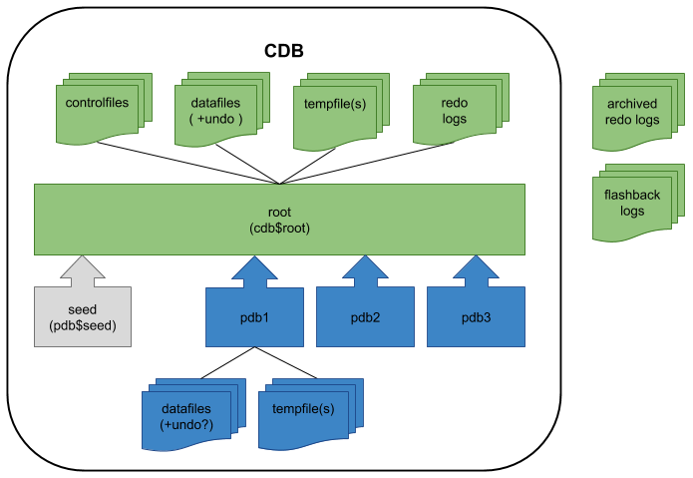
Oracle – Container databases …

Slide 11
Oracle – Container databases (cont.)
As per: https://oracle-base.com/articles/12c/multitenant-overview-container-database-cdb-12cr1
NOTE: starting in version 12.2, the amount of shared memory allocated to each pluggable database is configurable.
The multitenant option represents one of the biggest architectural changes in the history of the Oracle database. The option introduced the concepts of the Container Database (CDB) and Pluggable Database (PDB).
Container Database (CDB) : On the surface this seems very similar to a conventional Oracle database, as it contains most of the working parts you will be already familiar with (controlfiles, datafiles, undo, tempfiles, redo logs etc.). It also houses the data dictionary for those objects that are owned by the root container and those that are visible to all PDBs.
Pluggable Database (PDB) : Since the CDB contains most of the working parts for the database, the PDB only needs to contain information specific to itself. It does not need to worry about controlfiles, redo logs and undo etc. Instead it is just made up of datafiles and tempfiles to handle it's own objects. This includes it's own data dictionary, containing information about only those objects that are specific to the PDB. From Oracle 12.2 onward a PDB can, and should, have a local undo tablespace.

Slide 12
Oracle – Architecture (recap)
Oracle – connection based through Listener acting as service broker
Database Server
Client Application
Oracle Listener
Oracle Service
SQL Request to “Instance”
Lookup and Forward
Oracle Database (Files for Instance)
Oracle Instance
Oracle Instance
Oracle Instance
Data
Tables, indexes, …
Logs
Redo/Undo, Archive, …
Control and other files
Processes for buffers, logs, updates, etc
Shared Memory
Synch

